Slide 1
JavaScript
Events
PHP web development 2020/2021
Milena Tomova
Vratsa Software
https://vratsasoftware.com/

Slide 2
Table of Contents
JavaScript Event Model
Registering events
HTML Attributes,
DOM Properties
DOM methods
Event object

Slide 3
JavaScript Event Model

Slide 4
JavaScript Event Model
JS Event Model
DOM event model - allows user-browser interaction
Consists of event/events and event listener(s), attached to a DOM object

Slide 5
Event Types

Slide 6
Event types
event types
Event type groups
Mouse events
Touch events
Form events
Keyboard events
DOM events
Custom events
Full event types list

Slide 7
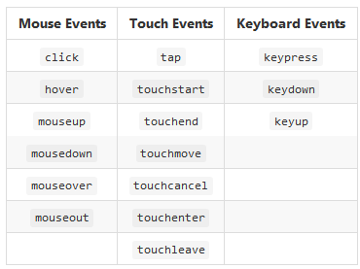
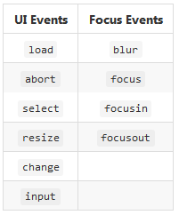
Event Types

Slide 8
Registering an
Event

Slide 9
Event Handlers
Event Handler
Registering an event through a callback function for a specific event type and for a specific DOM element/s
We can register event as -
a HTML attribute
using a DOM property
using DOM event handler

Slide 10
HTML Attribute
in HTML
<button onclick="onButtonClick()">Click Me</button>
in JS
function onButtonClick() { console.log("You clicked the Button"); }

Slide 11
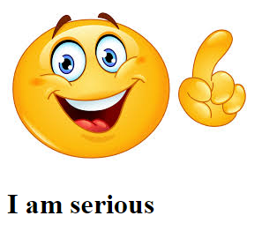
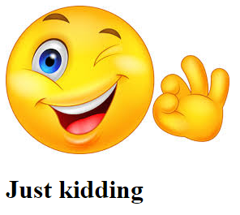
As an HTML Attribute - TASK
Напишете JS, с който при преминаване с мишката над картинката - от усмихната става сериозна и текста под картинката се променя от
I am serious на Just Kidding!

Slide 12
Register Event Handlers using a property of a DOM element
Register Event Handlers using a property of a DOM element
html
<button id="click-button">Click me</button>
JavaScript
var button = document.getElementById("click-button"); button.onclick = function onButtonClick() { console.log("You clicked the button"); }
a JS is prepared /the button with id=click-button/
it waits for an event - to be clicked /button.onclick/
and will do what is set in the script /console.log("You clicked the button")/

Slide 13
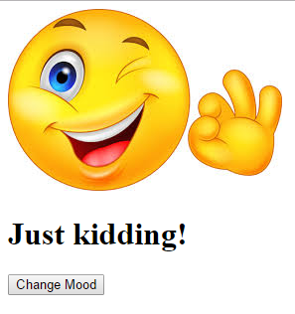
Register ... a property of a DOM element - task
Напишете JS код, който сменява настроението на Smiley след натискане на бутон.

Slide 14
Using DOM Event Listeners
domElement.addEventListener(eventType, eventHandler, isCaptureEvent);
var button = document.getElementById("click-button"); button.addEventListener("click", whenClickedFunc, false);
function whenClickedFunc() { console.log("You clicked me"); }
var button = document.getElementById("click-button"); button.addEventListener("click", function () { console.log("You clicked me"); }, false);

Slide 15
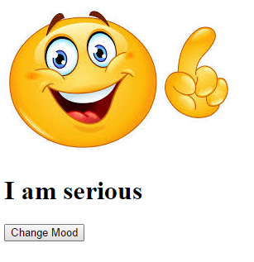
Using DOM Event Listeners - TASK
Напишете JS код, който сменява настроението на Smiley след натискане на бутон. Използвайте слушател на събитие.

Slide 16
Event Object

Slide 17
Event Object
Event Object
When handling an event we/event handlers/ have access to the event object.
It contains info for -
the event type
event target
the key /if keyboard event/ that has triggered the event
the mouse button /if mouse event/ that has been clicked and triggered the event
the mouse position on the screen
For debugging purposes

Slide 18
Event Object
to access the event target
function onButtonClick(event) { console.log(event.target); console.log(event.type); console.log(event.clientX, event.clientY); }
button.addEventListener("click", onButtonClick, false);

Slide 21



Trainings @ Vratsa Software
Vratsa Software – High-Quality Education, Profession and Jobs
www.vratsasoftware.com
The Nest Coworking
www.nest.bg
Vratsa Software @ Facebook
www.fb.com/VratsaSoftware
Slack Channel
www.vso.slack.com

